Slide 1
Preparation
Start Raven.
Open Raven Mgmt http://localhost:8080/.
Open 3 examples in VS.
Open ReadStore.sql

Slide 2
DDD, CQRS and Event Sourcing

Slide 3
Domain-Driven Design

Slide 4
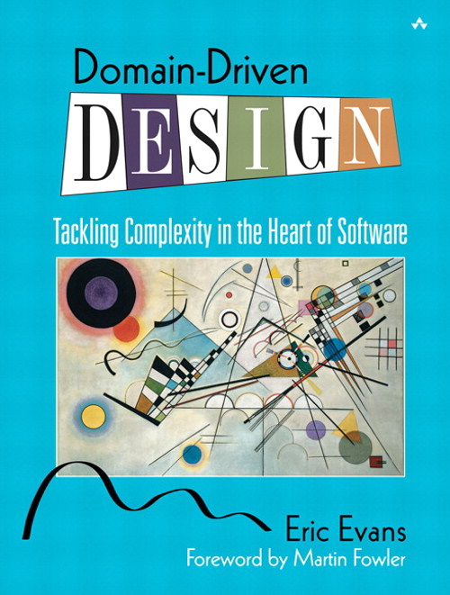

Slide 5
What is a DDD “Domain”?

Slide 6
What’s in a Domain?

Slide 7
Entities
Have “identity”.
Encapsulate data with behaviours.
No infrastructure code. None. Nada.

Slide 8
Value Objects
Don’t typically have identity.
Don’t have to be primitive types.
Consider PostalCode rather than string.
Consider immutability.

Slide 9
Entities + Value Objects = Aggregates

Slide 10
Aggregates...
Are object graphs.
Define consistency boundaries.
Contain behaviour and invariant logic.
Have an Aggregate Root.

Slide 11
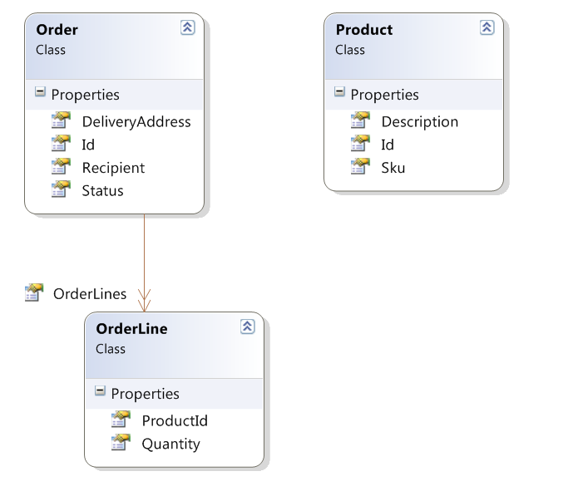

Slide 12
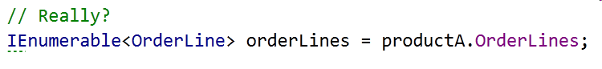

Slide 13
Ubiquitous Language

Slide 14
A word of warning...

Slide 15
If the only verbs in your Ubiquitous Language are Create, Delete and Change, you probably should not be using DDD.

Slide 16
Refactoring toward deeper insight

Slide 17
Application Services
Classes that coordinate behaviour of Domain Objects
DO NOT contain “business logic”
MVC controllers are probably not Application Services
Perform IoC and infrastructure duties

Slide 18
SHOW ME TEH Codez

Slide 19
But why?

Slide 20
Benefits of DDD
Encapsulation of business rules.
Easy testing of business rules.
OOP techniques manage complexity.

Slide 22
CQRS

Slide 23
CQRS is really just CQS
(but at an architectural level)

Slide 24
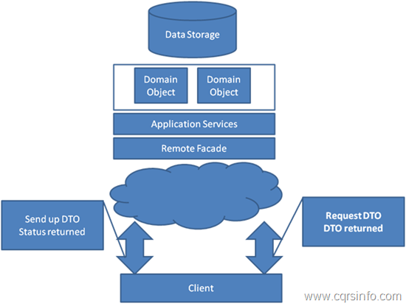
Stereotypical Architecture

Slide 25
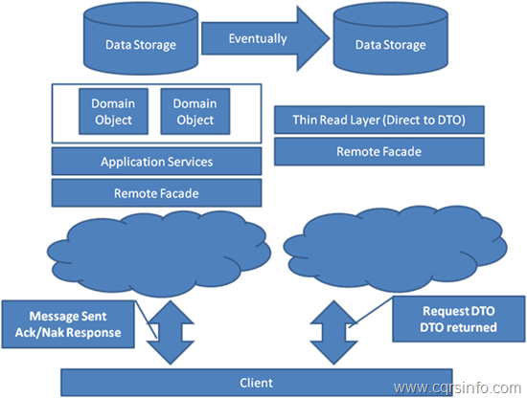
CQRS Architecture

Slide 26
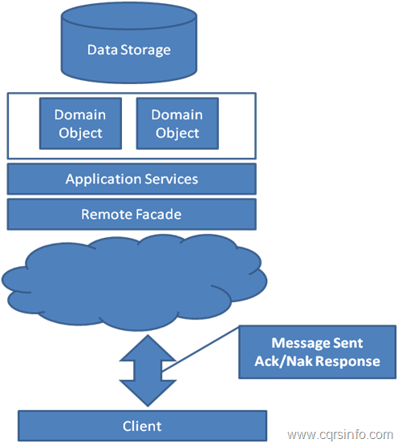
CQRS “Command Side”

Slide 27
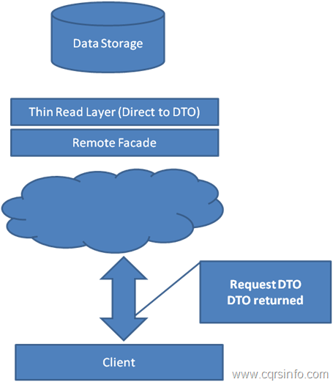
CQRS “Query Side”

Slide 28
CQRS is not “multiple databases”

Slide 29
SHOW ME TEH Codez

Slide 31
Eventual Consistency

Slide 32
You have eventual consistency if:
probably
^
You don’t have pessimistic locking
You display data on a screen
Data is in more than one place*
(* The real world is a place, too...)

Slide 33
Your DB is only what you THINK you know...

Slide 34
Don’t call it that!
It’s not “wrong”, it’s very slightly out of date

Slide 35
But why?

Slide 36
Benefits of CQRS
Handles complexity well.
Two models that do their jobs well.
Scalability.
Enables Event Sourcing...

Slide 37
Event Sourcing

Slide 38
Don’t store Entities, store the Events that got them to where they are

Slide 39
Rehydrate by replaying events

Slide 40
Commands vs. Events

Slide 41
Commands
Are data structures, not objects
The name says “what”, the properties say “who, where, why, when, how” as appropriate
Present tense, imperative mood
Can fail or be rejected
Are analogous to method calls

Slide 42
Use-Case
Task
Command
Method Call

Slide 43
Events
Are data structures, not objects
The name says “what”, the properties say “who, where, why, when, how” as appropriate
Are past-tense
Cannot be failed or rejected

Slide 44
SHOW ME TEH Codez

Slide 45
But why?

Slide 46
Benefits of Event Sourcing
Append-only database.
Unit testing.
Time travelling.
Domain integration.
Rebuilding read-stores.

Slide 47
Resources
Eric Evans’ “Blue Book”
cqrs.wordpress.com
Greg’s 3-day course
MS P&P “CQRS Journey”
Regalo + Vita on Github
Notes:
http://codebetter.com/gregyoung/2010/02/16/cqrs-task-based-uis-event-sourcing-agh/
http://www.udidahan.com/2009/12/09/clarified-cqrs/
http://codebetter.com/gregyoung/

Slide 48
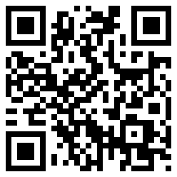

Neil Barnwell
@neilbarnwell
www.neilbarnwell.co.uk

